Slide 1
TCP/IP CHAT APPLICATION ON DESKTOP
Instructor: MSc Vo Van Luong
Student implementation: Phan Minh Hoang Thai - 23IT.EB038 - 23ITe2
Phuong Thao Nguyen - 23IT.EB098 - 23ITe2

Slide 2
CONTEXT:
The rapid development of the Internet and information technology.
The need for online communication and information exchange is increasing.
REASONS FOR CHOOSING TOPIC:
Meet users' need for quick and effective communication.
Create a secure and convenient communication support tool.
TARGET:
Build a chat application with a friendly, secure and effective interface.
Integrating advanced technologies such as Java, MySQL, Socket programming.

Slide 3
IMPLEMENTATION METHODS:
Java: The main programming language used to develop applications.
JDBC: Tool to connect and interact with MySQL database.
Multithreading: The technique handles multiple simultaneous connections, ensuring the application can serve multiple users at the same time.
MySQL: A database management system is used to store user information and messages.
JavaFX: Technology to create intuitive and user-friendly user interfaces.
Socket: Network protocol for communication between devices in the application.

Slide 4

APPLICATION FUNCTIONS:
Register an account.
Log in to your account.
Delete the account.
Change the password.
Group messaging.
Direct message.
Make friend.

Slide 5
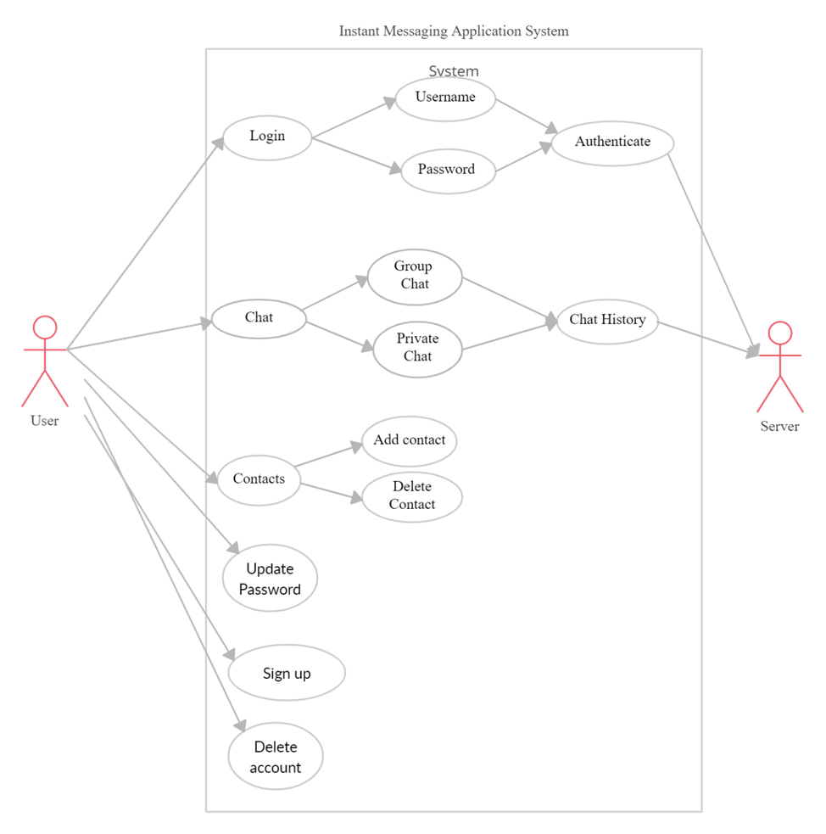
USE-CASE DIAGRAM:

Slide 6
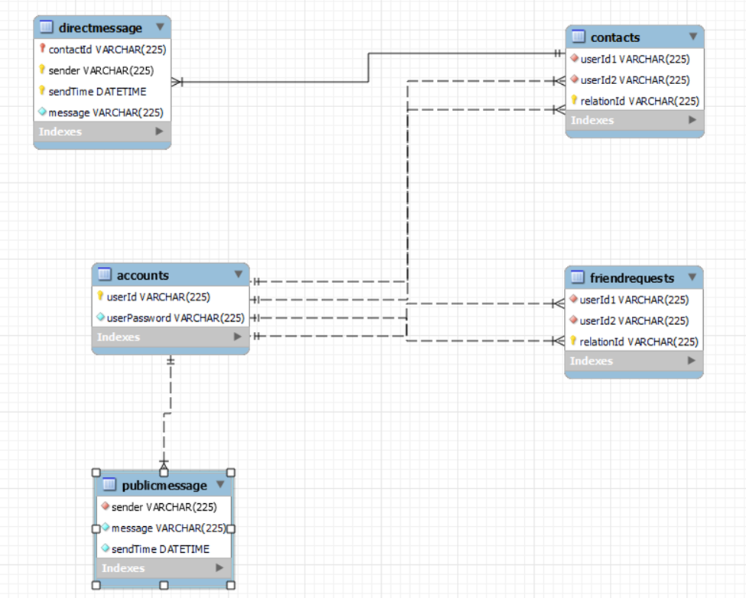
DATABASE DIAGRAM:

Slide 7
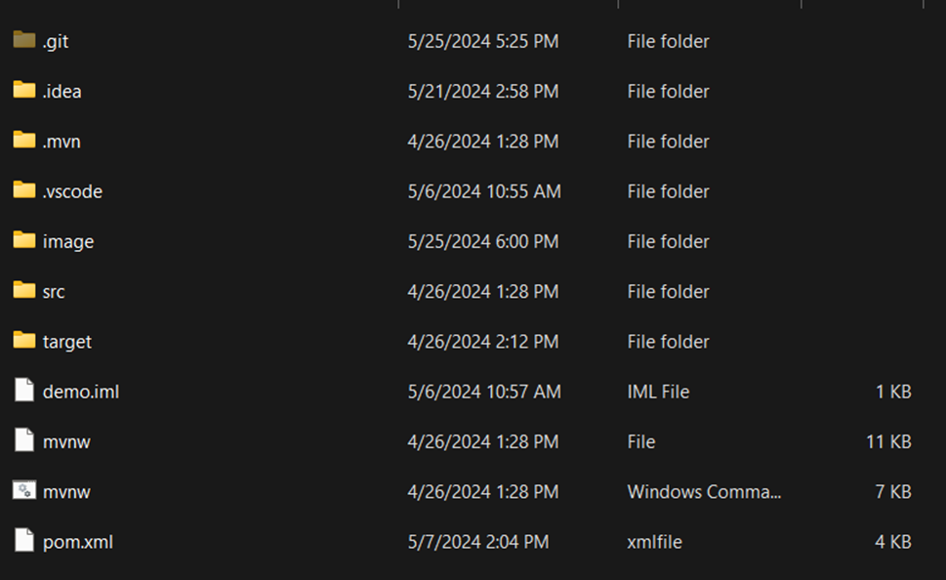
BIBLIOGRAPHY LIST:

Slide 8
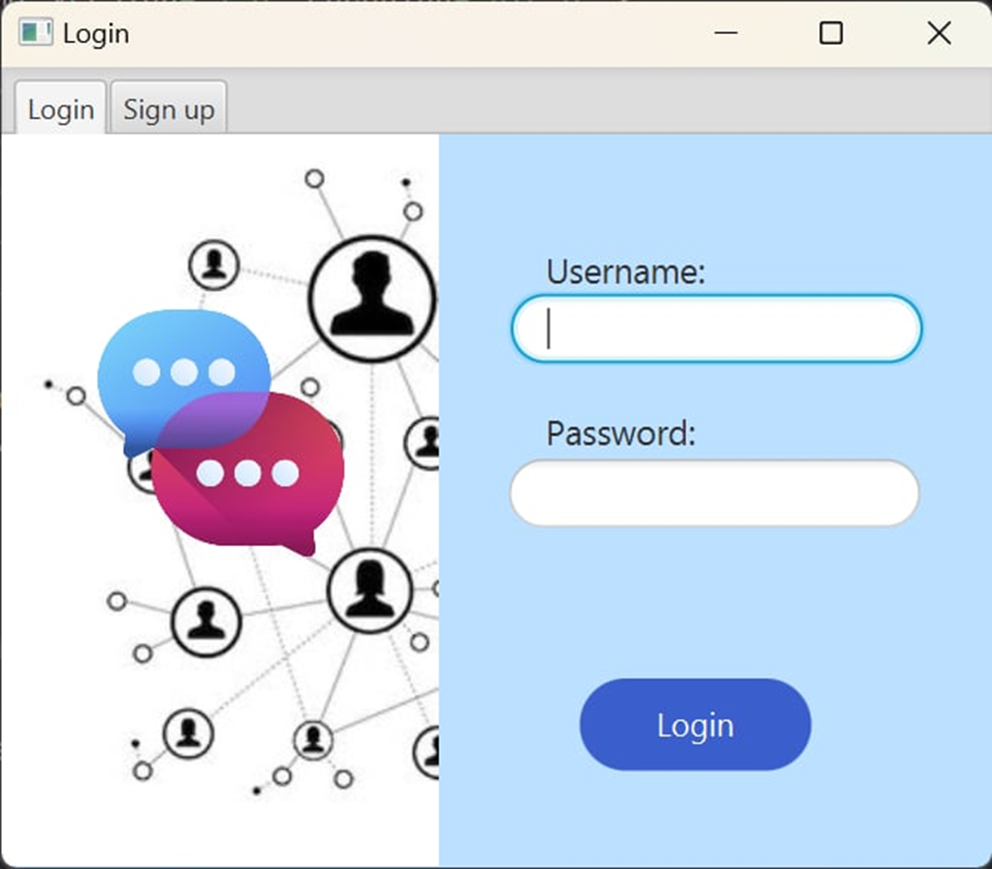
LOGIN INTERFACE:

Slide 9
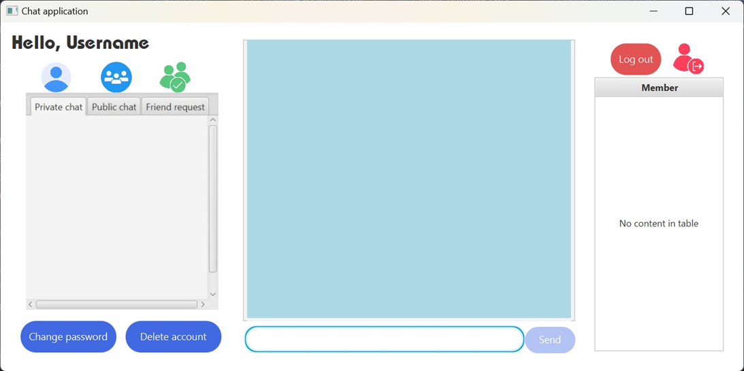
APPLICATION INTERFACE:

Slide 10
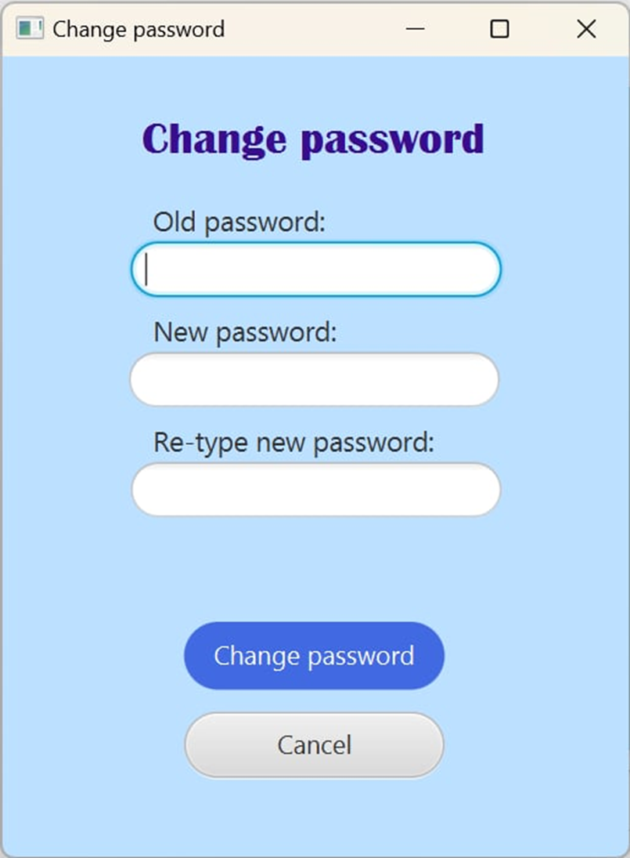
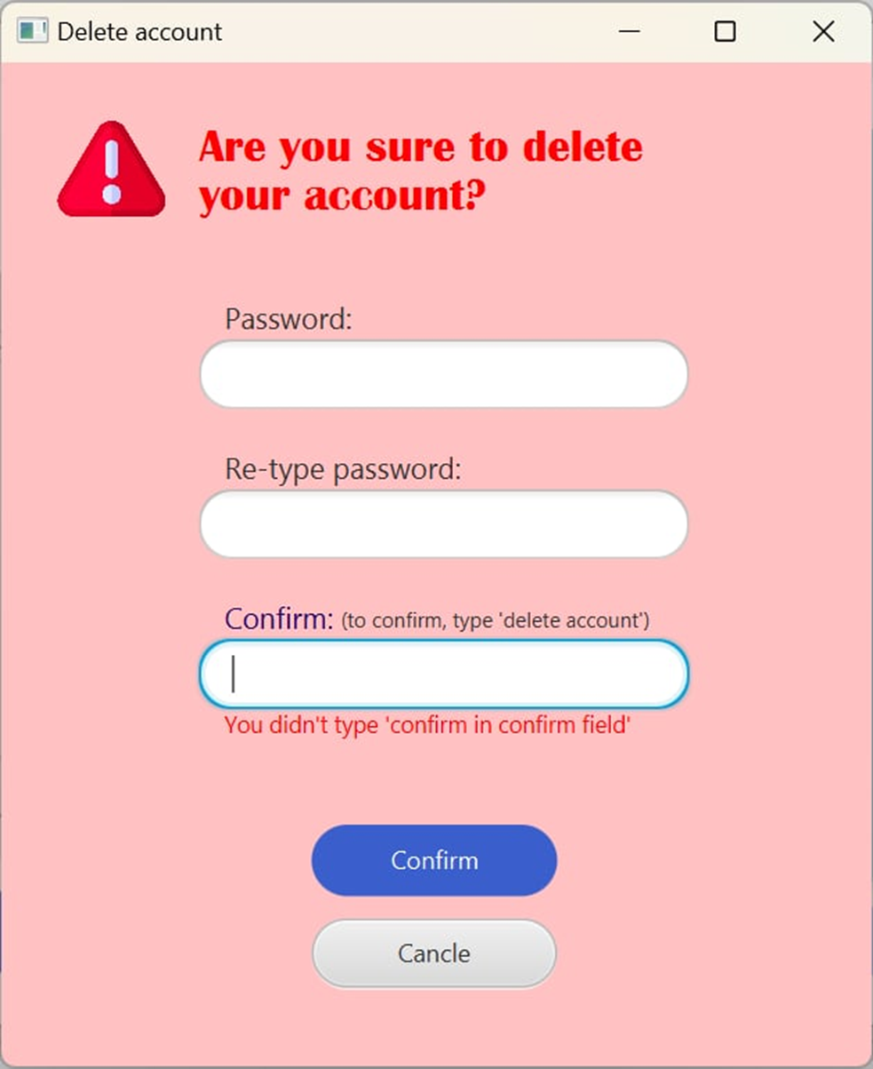
CHANGE PASSWORD INTERFACE:
ACCOUNT DELETION INTERFACE:

Slide 11
RESULT:
Complete chat application with user-friendly and easy-to-use interface.
The feature of sending and receiving messages works stably and securely.
Improve Java programming skills and computer network knowledge for the implementation team.
Some limitations:
Processing speed is not high when there are many concurrent users.
Some errors that arise during use have not been completely resolved.
DEVELOPMENT:
Optimize application processing speed.
Add new features such as sending files, video calling.
Enhance user experience and increase security.

Slide 12
KẾ HOẠCH PHÁT TRIỂN BẢN THÂN
Thank you everyone for listening attentively

